Slide 1
Physics 2335
Section 001
Monday, 9/22/25
ExpertTA Homework 2 due Monday 9/22
The Ideal Gas Law tutorial homework due Monday 9/22
Reading Quiz 4 due Wednesday 9/24
ExpertTA Homework 3 due Monday 9/29

Slide 2
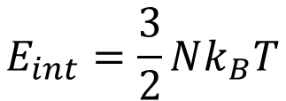
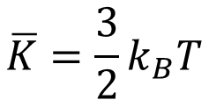
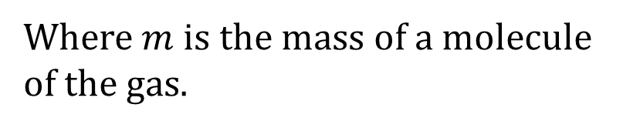
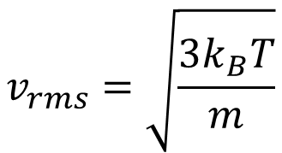
In an ideal gas, all of the energy is kinetic, and the average kinetic energy per molecule is given by
$$\overline{K}=\frac{3}{2}k_{B}T$$
This means that the total energy of the system is given by
$$E_{int}=\frac{3}{2}Nk_{B}T$$
From this we can get the rms speed of the molecules in the gas
$$v_{rms}=\sqrt{\frac{3k_{B}T}{m}}$$
Where $m$ is the mass of a molecule of the gas.

Slide 3
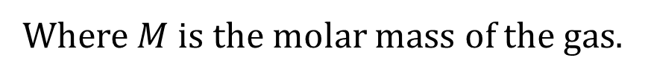
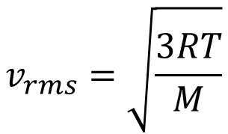
In terms of the molar mass, we have
$$v_{rms}=\sqrt{\frac{3RT}{M}}$$
Where $M$ is the molar mass of the gas.

Slide 4
QuickCheck 18.3
A rigid container holds both hydrogen gas (H₂) and nitrogen gas (N₂) at 100°C. Which statement describes their rms speeds?
v_{rms} of H₂ < v_{rms} of N₂.
v_{rms} of H₂ = v_{rms} of N₂.
v_{rms} of H₂ > v_{rms} of N₂.
Slide 18-34
Notes:
4

Slide 5
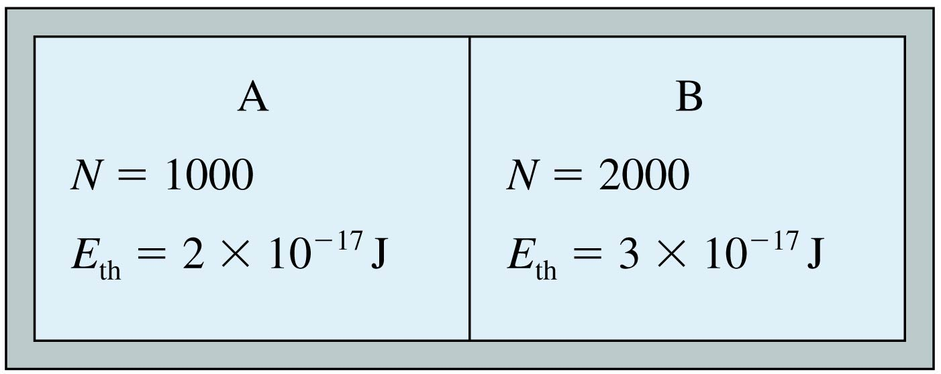
QuickCheck 18.6
Systems A and B are both monatomic gases. At this instant,
T_{A} > T_{B}.
T_{A} = T_{B}.
T_{A} < T_{B}.
There’s not enough information to compare their temperatures.
Slide 18-51
Notes:
5

Slide 6
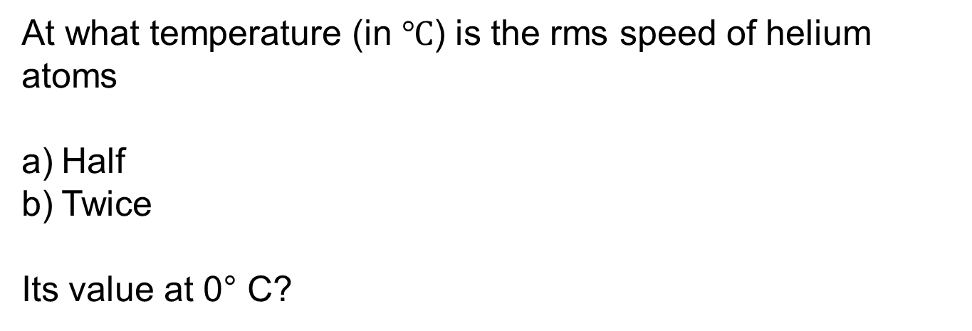
At what temperature (in $℃$) is the rms speed of helium atoms
Half
Twice
Its value at 0° C?

Slide 7
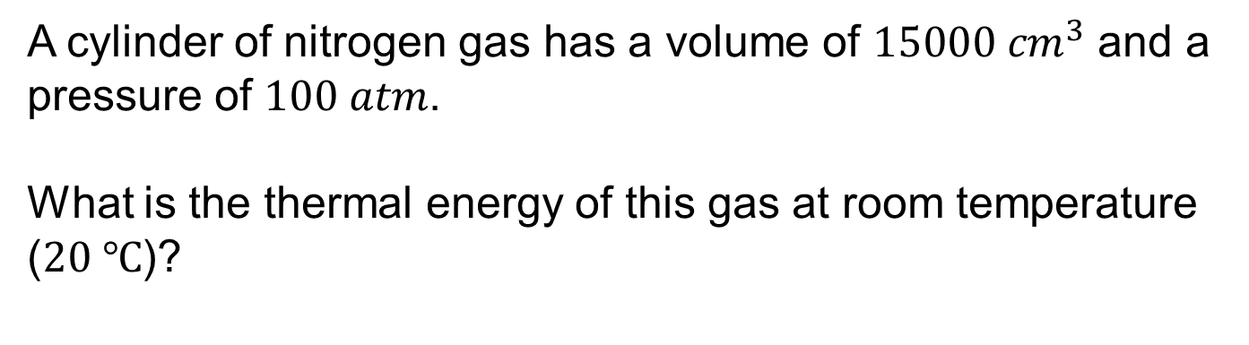
A cylinder of nitrogen gas has a volume of $15000 {cm}^{3}$ and a pressure of $100 atm$.
What is the thermal energy of this gas at room temperature ($20 ℃$)?

Slide 8
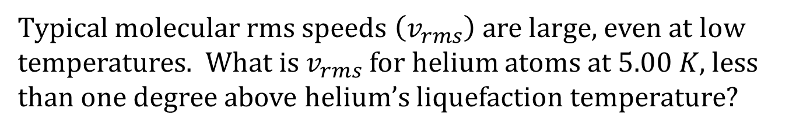
Typical molecular rms speeds $\left(v_{rms}\right)$ are large, even at low temperatures. What is $v_{rms}$ for helium atoms at $5.00 K$, less than one degree above helium’s liquefaction temperature?

Slide 9
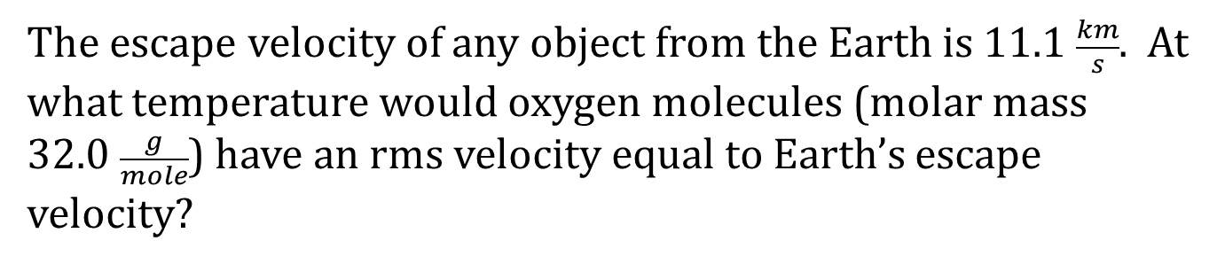
The escape velocity of any object from the Earth is $11.1 \frac{km}{s}$. At what temperature would oxygen molecules (molar mass $32.0 \frac{g}{mole}$) have an rms velocity equal to Earth’s escape velocity?

