Slide 1

Engineering Economic Analysis
Chapter 2
Estimating Engineering Costs & Benefits
Donald G. Newnan
San Jose State University
Ted G. Eschenbach
University of Alaska Anchorage
Jerome P. Lavelle
North Carolina State University
Neal A. Lewis
Fairfield University

Slide 2
Chapter Outline
Fixed, variable, marginal, & average costs
Considering all costs
Estimating benefits
The estimating process
Estimating models
Cash flow diagrams

Slide 3
Learning Objectives
Understand cost & benefit concepts
Understand cost estimation models
Estimate engineering costs
Understand relationship between cost & benefit estimating
Draw cash flow diagrams

Slide 4
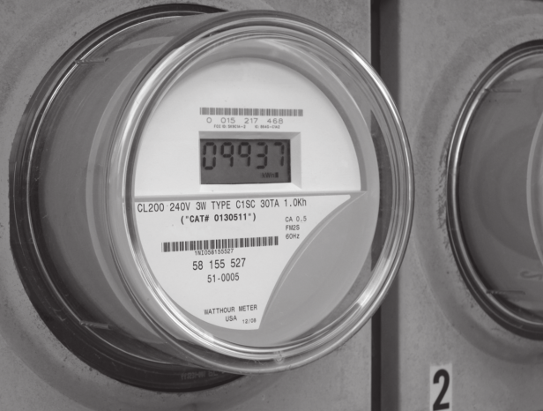
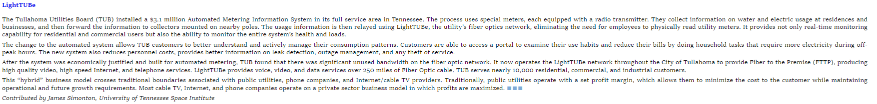
Vignette: Automated Metering Information System
Tullahoma Utilities Board (TUB) installed a
$3.1 M automated metering system
Usage information is relayed using LightTUBe,
a ﬁber optics network
After system justiﬁed & built, it had unused
bandwidth
LightTUBe now provides high quality video, high speed Internet, telephone services
“Hybrid” business model crosses traditional boundaries with public utilities, phone companies, & Internet/cable TV providers

Slide 5
Vignette: Automated Metering Information System
Questions to Consider:
  How to estimate cost & beneﬁts of “hybrid” operation (max profit) with traditional utility business (min cost)?
  Ethical issues in using public funds in what could be seen as a for-proﬁt venture competing with private sector firms
  LightTUBe would be able to consider both what it collects & consumer surplus value. How should this be handled?
  When analyzing economics of “hybrid” projects, what tools would be appropriate?

Slide 6
Types of Costs
Fixed costs & variable costs
Marginal costs & average costs
Sunk costs & opportunity costs
Recurring & non-recurring costs
Incremental costs
Cash costs & book costs
Life-cycle costs

Slide 7
Fixed Costs & Variable Costs
Fixed costs: constant, unchanging regardless of the level of output or activity
  Property taxes, insurance
  Management & administrative salaries
  License fees
  Rent or lease
Variable costs: vary with output or activity level
  Direct labor cost
  Direct materials

Slide 8
Marginal Costs & Average Costs
Marginal costs: variable cost for 1 more unit
  Capacity Planning: Cost of excess capacity
  Basis for last-minute pricing
Average costs: total cost / # units
  Basis for normal pricing

Slide 9
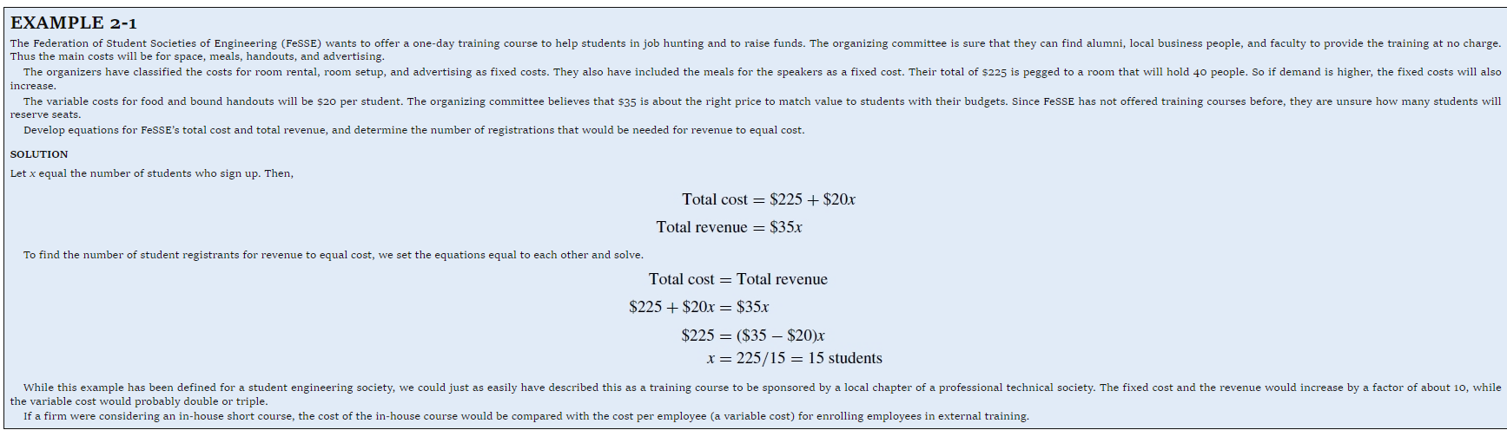
Example 2-1
Fixed costs: $225
Variable costs: $20 / student
Revenue: $35 / student
Total cost = $225 + $20x
Total revenue = $35x
At breakeven, Total cost = Total revenue
$225 + $20x = $35x
x = 15 students

Slide 10
Example 2-1
Total Revenue
= 35x
$1000
Profit
Total Costs
= $225 + 20x
$800
Variable Costs
= 20x
$600
$400
Fixed Costs
= $225
$200
Loss
Breakeven point
x
# of Customers
$0
5
10
15
20
25

Slide 11
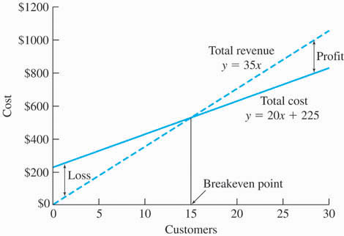
Example 2-1
You have 15
Customers. Your
profit is:
Negative
Positive
Small
Zero
I don’t know
Notes:
D

Slide 12
Example 2-1
You have 15
Customers. Your
profit is:
Negative
Positive
Small
Zero
I don’t know
At breakeven, profit is zero.
Notes:
D

Slide 13
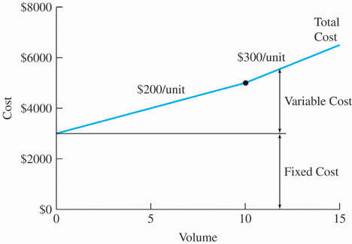
Figure 2-2
If volume = 5,
Fixed cost is $3000, variable cost is $200/unit.
Fixed cost is $3000, variable cost is $1000/unit.
Fixed cost is $300/unit, variable cost is $200/unit.
Total cost is $3000 + $300x
I’m confused.
Notes:
A

Slide 14
Figure 2-2
If volume = 5,
Fixed cost is $3000, variable cost is $200/unit.
Fixed cost is $3000, variable cost is $1000/unit.
Fixed cost is $300/unit, variable cost is $200/unit.
Total cost is $3000 + $300x
I’m confused.
Notes:
A

Slide 15
Profit & Loss Terms
Breakeven: activity level where
total revenue = total costs
  Just getting by
Profit region: total revenue > total costs
  Putting money in the bank
Loss region: total revenue < total costs
  Losing money

Slide 16
Sunk Costs & Opportunity Costs
Sunk costs: money already spent due to past decision
  Purchase price paid for a car 2 years ago
Opportunity costs: cost of the foregone opportunity, often hidden or implied
  Existing equipment in replacement analysis
  Income not received from the job you turn down
  Paying the mortgage instead of going out for dinner

Slide 17
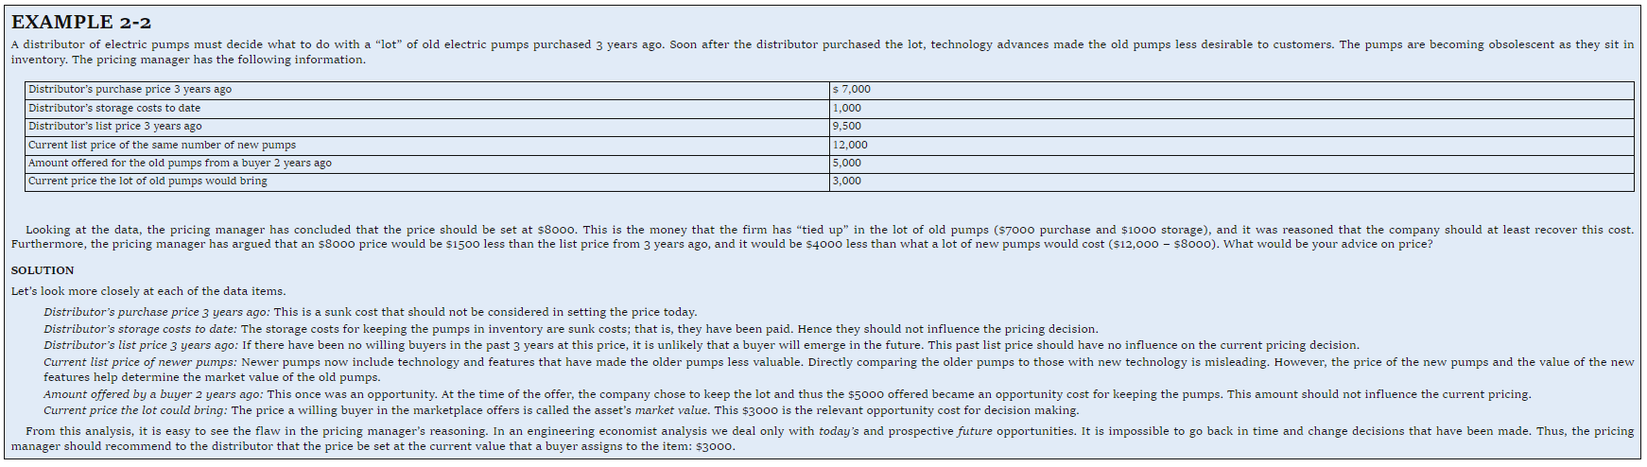
Example 2-2 Pricing of Old Pumps
Purchase Price of Old Pumps $7,000 (Sunk)
Storage Costs of Old Pumps $1,000 (Sunk)
List Price of Old Pumps (3yrs) $9,500 (Irrelevant)
List Price of New Pumps $12,000 (Irrelevant)
Offer of Old Pumps (2 yrs ago) $5,000 (Irrelevant)
Current Price of Old Pumps $3,000

Slide 18
Recurring Costs & Non-recurring Costs
Recurring costs: repetitive to produce similar goods & services
  Office space rental
  Material cost for a product
Non-recurring costs: not repetitive; one time
  Purchase cost for real estate,
  Construction costs of the plant
Some large non-recurring costs can be planned for by buying insurance, turning this into a recurring cost

Slide 19
Incremental Costs
Incremental costs: difference in costs between two alternatives.
  Suppose that A & B are mutually exclusive
  A has an initial cost of $10,000
  B has an initial cost of $14,000
  Incremental initial cost of (B − A) = $4000

Slide 20
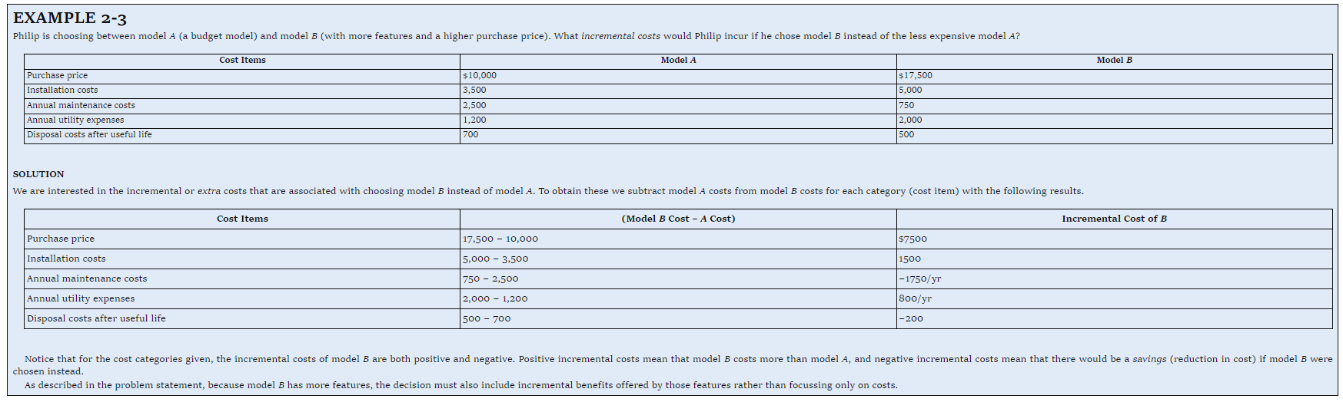
Example 2-3
Choosing between Models A & B
Cost Items | Model A | Model B | Incremental Cost
Purchase Price | $10,000 | $17,500 | $7,500
Installation Costs | 3,500 | 5,000 | 1,500
Annual Maintenance | 2,500 | 750 | −1,750
Annual Utility | 1,200 | 2,000 | 800
Disposal Cost | 700 | 500 | −200

Slide 21
Example 2-3
Choosing between Model A & B
Incremental cost = Cost of B – Cost of A
A positive incremental cost means
A costs more than B
B costs more than A
The incremental cost is a good thing
We save money if we buy A
I don’t know
Notes:
B

Slide 22
Example 2-3
Choosing between Model A & B
Incremental cost = cost of B – cost of A
A positive incremental cost means
A costs more than B
B costs more than A
The incremental cost is a good thing
We save money if we buy A
I don’t know
Notes:
B

Slide 23
Cash vs. Book Costs
Cash costs: money from one owner to another: cash flow
  This month’s loan payment
Book cost: transaction cost as recorded in an accounting book
  Depreciation cost calculated this year for an existing asset, per accounting department

Slide 24
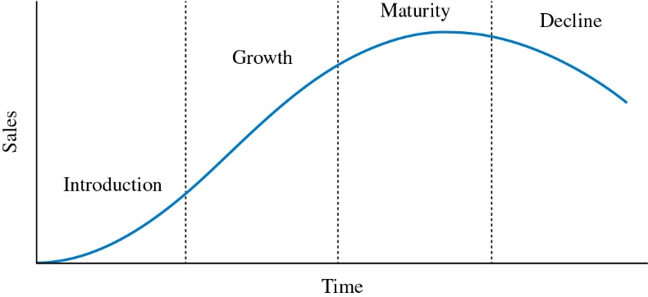
Life-Cycle Costs
Life-cycle costs: all costs over its entire life of a product, structure, system, or service
Life cycle costing: design products, projects, & services recognizing all costs & benefits over the entire life cycle

Slide 25
Life-Cycle Costs
Which is true?
Life-cycle: time from conception to death of a product or process
Life-cycle costs: all costs incurred during life cycle
Life-cycle costing: proper basis for economic choices
All of the above
None of the above
Notes:
D

Slide 26
Life-Cycle Costs
Which is true?
Life-cycle: time from conception to death of a product or process
Life-cycle costs: all costs incurred during life cycle
Life-cycle costing: proper basis for economic choices
All of the above
None of the above
All of the above are true.
Notes:
D

Slide 27
Phases of Life-Cycle
1. Needs Assessment | 2. Conceptual Design | 3. Detailed Design | 4. Production /Construction | 5.Operational Use | 6. Decline/ Retirement
Requirements Analysis | Impact Analysis | Allocation of Resources | Production of Goods/ Services | Distribution of Goods/ Services | Phase Out
Overall Feasibility Study | Proof of Concept | Detailed Specifications | Building of Supporting Facilities | Maintenance/ Support | Disposal
Conceptual Design Planning | Prototype/ Breadboard | Component/ Supplier Selection | Quality Control/ Assurance | Retirement Planning
 | Development/ Testing | Production Planning | Operational Planning
 | Detailed Design Planning

Slide 28
Cumulative Life-Cycle Costs
Committed & Spent
100%
90%
80%
70%
Life-Cycle Costs Committed
60%
50%
Life-Cycle Costs Spent
40%
30%
20%
10%
0%
Need
Conceptual
Detailed
Production
Operational
Decline/
Assessment
Design
Design
/Construction
/Use
Retirement

Slide 29
Cost/Ease of Design Changes in
Product Life-Cycle
100%
90%
Ease of Design Changes
80%
70%
60%
Cost of Design Changes
50%
40%
30%
20%
10%
0%
Need
Conceptual
Detailed
Production
Operational
Decline/
Assessment
Design
Design
/Construction
/Use
Retirement

Slide 30
Why is there a gap between money committed & money spent?
Materials ordered & work done before vendors & workers paid
Design decisions largely determine costs to build, operate, & close-out
There is a time lag while funds are recorded & published by Accounting
All of the above
None of the above
Notes:
D

Slide 31
Why is there a gap between money committed & money spent?
Materials ordered & work done before vendors & workers paid
Design decisions largely determine costs to build, operate, … & benefits from product & project performance
There is a time lag while funds are recorded & published by Accounting
All of the above
None of the above
All are true, but B is the most important.
Notes:
D

Slide 32
Internal & External
Costs
Internal costs (materials, labor, overhead, etc.) used to calculate product/service cost
External costs are not directly incurred by the firm
  Cost of disposal, decommissioning, landfill
  Effects on wildlife & environment
  Effects on air & water quality

Slide 33
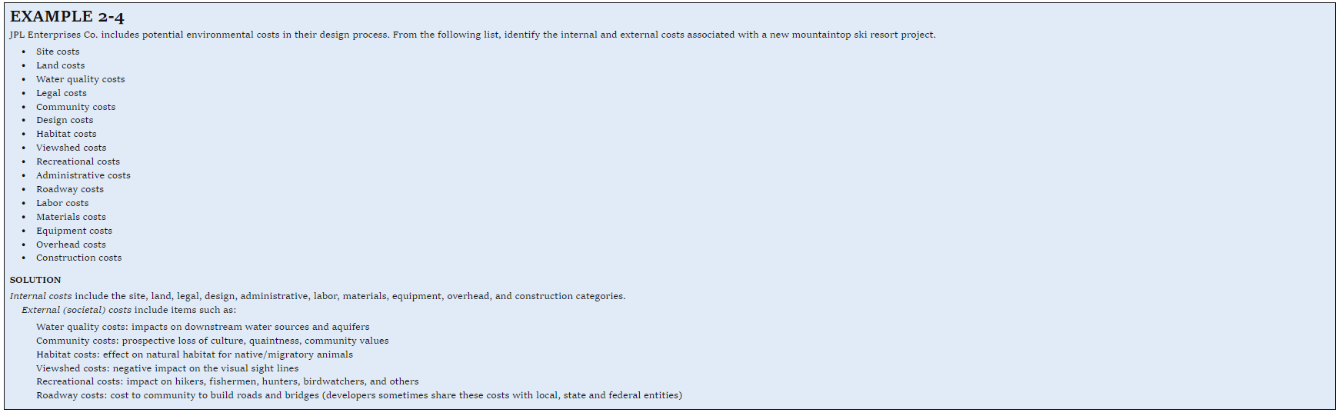
Example 2-4 Identify internal & external costs for new mountaintop ski resort project
Site costs
Land costs
Water quality costs
Legal costs
Community costs
Design costs
Habitat costs
Viewshed costs
Recreational costs
Administrative costs
Roadway costs
Labor costs
Materials costs
Equipment costs
Overhead costs
Construction costs

Slide 34
Example 2-4 Identify internal & external costs for new mountaintop ski resort project
Internal costs External costs
Site costs
Land costs
Water quality costs
Legal costs
Community costs
Design costs
Habitat costs
Viewshed costs
Recreational costs
Administrative costs
Roadway costs
Labor costs
Materials costs
Equipment costs
Overhead costs
Construction costs

Slide 35
Estimating Benefits
Benefits examples
  Sales of products
  Revenues from bridge tolls & electric power sales
  Cost reduction from reduced material or labor costs
  Reduced risk of flooding
Cost concepts & models apply to economic benefits
Like for costs uncertainty in benefit estimating is usually asymmetric; optimism is common
Benefits are often more difficult to estimate than costs

Slide 36
Cost Estimating
Economic analysis is future based
Future is not known with certainty
Types of cost estimating
  Rough estimates −30% to +60%
  Semi-detailed estimates −15% to +20%
  Detailed estimates −3% to +5%

Slide 37
Cost Estimating—Trade-off between Accuracy & Cost
High
Cost of Estimate
Low
Low
Medium
High
Accuracy of Estimate

Slide 38
Difficulties in Estimation
One-of-a-kind estimates
Time & effort available
Estimator expertise

Slide 39
Cost Estimating Models
Per-unit model
Segmenting model
Cost & price indexes
Power-sizing model
Triangulation
Improvement & the learning curve

Slide 40
Cost Estimating Models
Per-Unit Model
Per-Unit Model
  Construction cost per square foot (building)
  Capital cost of power plant per kW of capacity
  Revenue / maintenance cost per mile (hwy)
  Utility cost per square foot of floor space
  Fuel cost per kWh generated
  Revenue per customer served

Slide 41
A 1600 ft² clean manufacturing area recently cost $8 M. Use a per unit model to estimate cost of a new 2000 ft² area.
$0.8 million
$6.4 million
$8.0 million
$10.0 million
I don’t know
Notes:
C

Slide 42

A 1600 ft² clean manufacturing area recently cost $8 M. Use a per unit model to estimate cost of a new 2000 ft² area.
$0.8 million
$6.4 million
$8.0 million
$10.0 million
I don’t know
Notes:
C

Slide 43
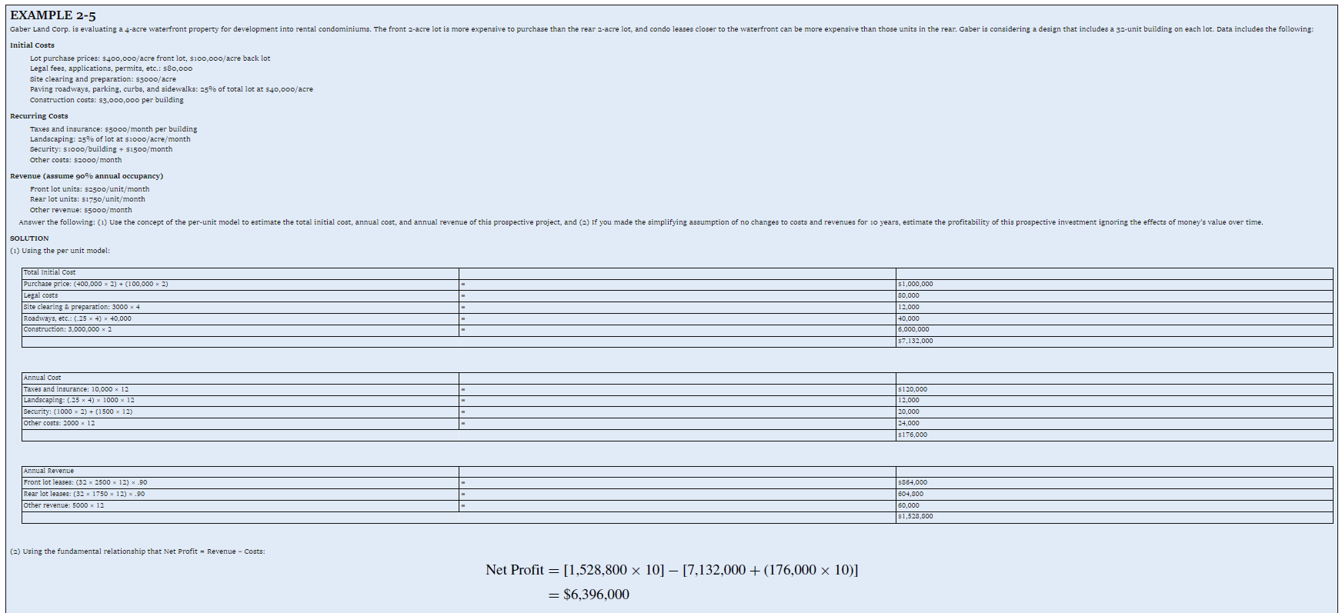
Example 2-5 Cost Estimating using Per-Unit Model
Evaluate 4-acre (front 2-acre + rear 2-acre) waterfront lots for rental condominiums (32-unit building on each lot)
Initial Costs
Purchase prices: $400,000/acre front, $200,000/acre back
Legal fees, applications, permits, etc.: $80,000
Site clearing & preparation: $3000/acre
Paving roadways, parking, curbs, & sidewalks: 25% of each lot at $40,000/acre
Construction costs: $3,000,000 per building

Slide 44
Example 2-5 continued
Example 2-4 Cost Estimating using Per-Unit Model
Recurring costs
  Taxes & insurance: $5000/month per building
  Landscaping: 25% of lot at $1000/acre/month
  Security: $1000/building + $1500/month
  Other costs: $2000/month
Revenue (assume 90% annual occupancy)
  Front lot units: $2500/unit/month
  Rear lot units: $1750/unit/month
  Other revenue: $5000/month
Estimate
  Initial cost, annual cost, & annual revenue
  Ignoring time value of money estimate proﬁtability

Slide 45
Example 2-5 continued
Solution:
Initial cost
Purchase price: (400,000×2) + (200,000×2) = $1,000,000
Legal costs = 80,000
Site clearing & preparation: 3000×4 = 12,000
Roadways, etc.: (.25×4)×40,000 = 40,000
Construction: 3,000,000×2 = 6,000,000
      $7,132,000
Annual cost
Taxes & insurance: 10,000×12 = $120,000
Landscaping: (.25×4)×1000×12 = 12,000
Security: (1000×2) + (1500×12) = 20,000
Other costs: 2000×12 = 24,000
$176,000
Copyright Oxford University Press 2014

Slide 46
Example 2-5 continued
Solution:
Annual revenue
Front lot leases: (32×2500×12) × .90 = $864,000
Rear lot leases: (32×1750×12) × .90 = 604,800
Other revenue: 5000 × 12 = 60,000
  $1,528,800
  Net proﬁt over 10 years
  = [1,528,800 × 10] − [7,132,000 + (176,000 × 10)]
  = $6,396,000

Slide 47
Cost Estimating Models –
Segmenting Model
Estimate is decomposed into individual components
Estimates are made at component level
Individual estimates are aggregated back together

Slide 48
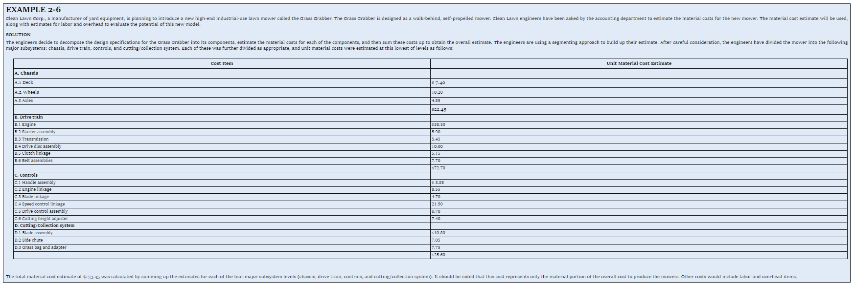
Example 2-6 Cost Estimating using Segmenting Model
Cost estimate of lawn mower
A. Chassis
B. Drive Train
Cost Item | Estimate
A.1 Deck | $7.40
A.2 Wheels | 10.20
A.3 Axles | 4.85
Subtotal | $22.45
Cost Item | Estimate
B.1 Engine | $38.50
B.2 Starter assembly | 5.90
B.3 Transmission | 5.45
B.4 Drive disc assembly | 10.00
B.5 Clutch linkage | 5.15
B.6 Belt assemblies | 7.70
Subtotal | $72.70

Slide 49
Example 2-6 Cost Estimating using Segmenting Model
Cost estimate of lawn mower
C. Controls
D. Cutting/Collection system
Cost Item | Estimate
C.1 Handle assembly | $3.85
C.2 Engine linkage | 8.55
C.3 Blade linkage | 4.70
C.4 Speed control linkage | 21.50
C.5 Drive control assembly | 6.70
C.6 Cutting height adjuster | 7.40
Subtotal | $52.70
Cost Item | Estimate
D.1 Blade assembly | $10.80
D.2 Side chute | 7.05
D.3 Grass bag & adapter | 7.75
Subtotal | $25.60
Total material cost = $22.45 + $72.70 + $52.70 + $25.60 = $173.45

Slide 50

Cost Estimating Models –
Cost Indexes
Cost indexes reflect historical change in cost
Cost index could be individual cost items (labor, material, utilities), or group of costs (consumer prices, producer prices)
Indexes can be used to update historical costs
(Eq. 2-2)

Slide 51
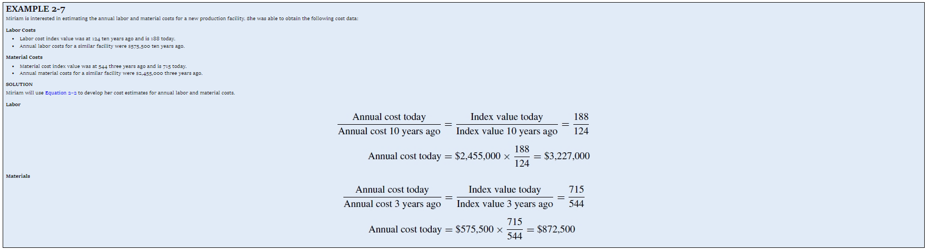
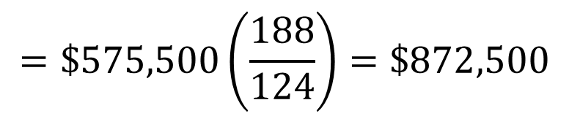
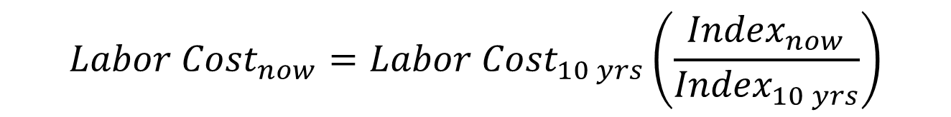
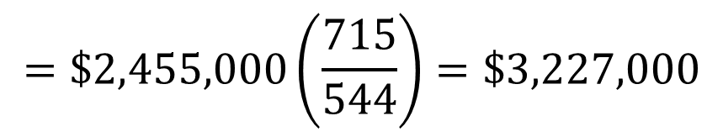
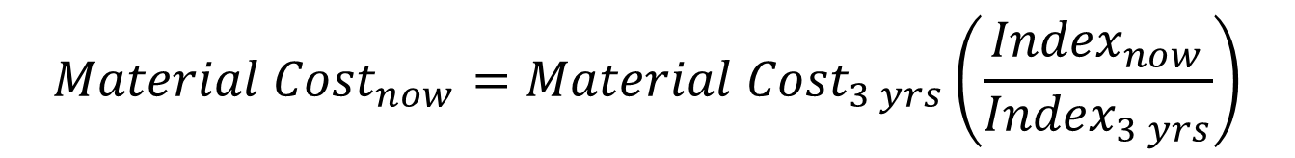
Example 2-7 Cost Estimating using Cost Indexes
$${Labor Cost}_{now}={Labor Cost}_{10 yrs}\left(\frac{{Index}_{now}}{{Index}_{10 yrs}}\right)$$
$$=\$575,500\left(\frac{188}{124}\right)=\$872,500$$
$${Material Cost}_{now}={Material Cost}_{3 yrs}\left(\frac{{Index}_{now}}{{Index}_{3 yrs}}\right)$$
$$=\$2,455,000\left(\frac{715}{544}\right)=\$3,227,000$$

Slide 52

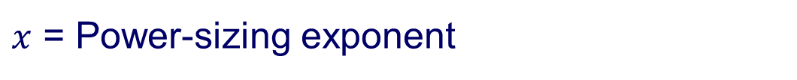
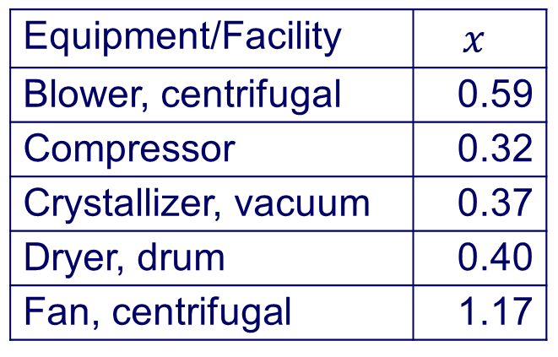
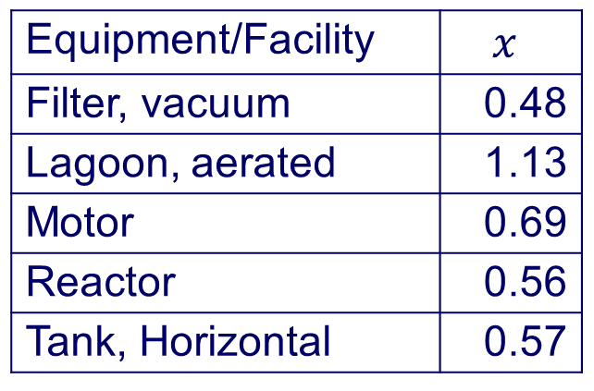
Cost Estimating Models
Power-Sizing Model
(Eq. 2-3)
Equipment/Facility
Blower, centrifugal | 0.9
Compressor | 1.0
Crusher | 0.8
Dryer, drum | 0.6
Electrostatic precipitators | 0.8
Equipment/Facility
Fan, 10³-10⁴ cfm | 0.4
Fan, 2x10⁴-7x10⁴ cfm | 1.2
Filter, plate & frame | 0.75
Jacketed vessels | 0.6
Motor | 0.9
Tank, Horizontal | 0.6

Slide 53




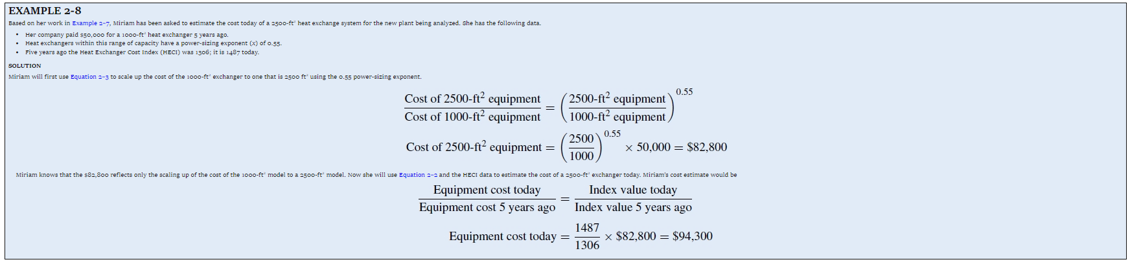
Example 2-8 Cost Estimating using Power-Sizing & Cost Indexes
A. Considering power-sizing index change
B. Considering cost index change

Slide 54
Cost Estimating Models –
Triangulation
Surveying technique: to map points of interest using fixed points, angles, & distances
  Extra points provide accuracy checks
Economic analysis: estimate from different perspectives, such as different source of data or different quantitative models

Slide 55
Cost Estimating Models –
Improvement & Learning Curve
Learning phenomenon: as # of repetitions increase performance is faster
  People learn, unneeded steps are dropped, methods & tools improve
Learning curve captures relationship between task performance & task repetition.
As output doubles the unit production time is reduced to some fixed percentage, the learning curve % or learning curve rate

Slide 56


Cost Estimating Models –
Improvement & Learning Curve
Learning curve
Let T₁ = Time to perform the 1st unit
T_{N} = Time to perform the N^{th} unit
b = Learning-curve exponent
N = Number of completed units
(Eq. 2-4)
(Eq. 2-5)

Slide 57
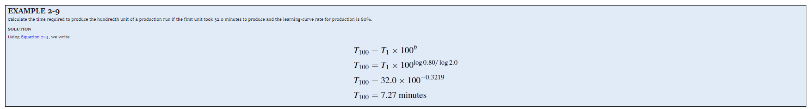

Example 2-9 Cost Estimating using Learning Curve
Let T₁ = 32.0 min
N = 100
Learning-curve rate = 80%
Solution:

Slide 58
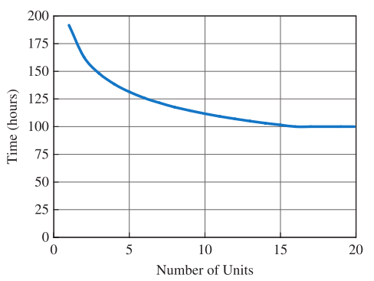
Example 2-9 Cost Estimating using Learning Curve
N | T_{N}
1 | 191.6
2 | 162.8
3 | 148.1
4 | 138.4
5 | 131.4
6 | 125.9
7 | 121.4
8 | 117.6
9 | 114.4
10 | 111.7
N | T_{N}
11 | 109.2
12 | 107.0
13 | 105.0
14 | 103.2
15 | 101.5
16 | 100.0
17 | 100.0
18 | 100.0
19 | 100.0
20 | 100.0
Example 2-9 Cost Estimating using
Learning Curve

Slide 59
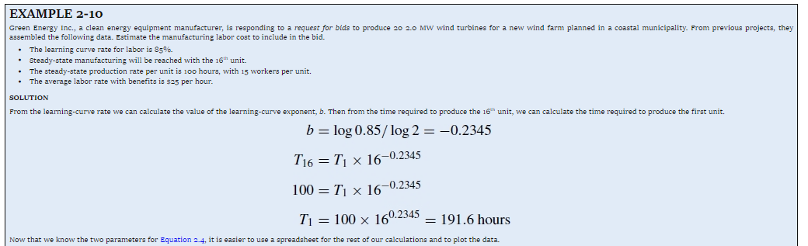
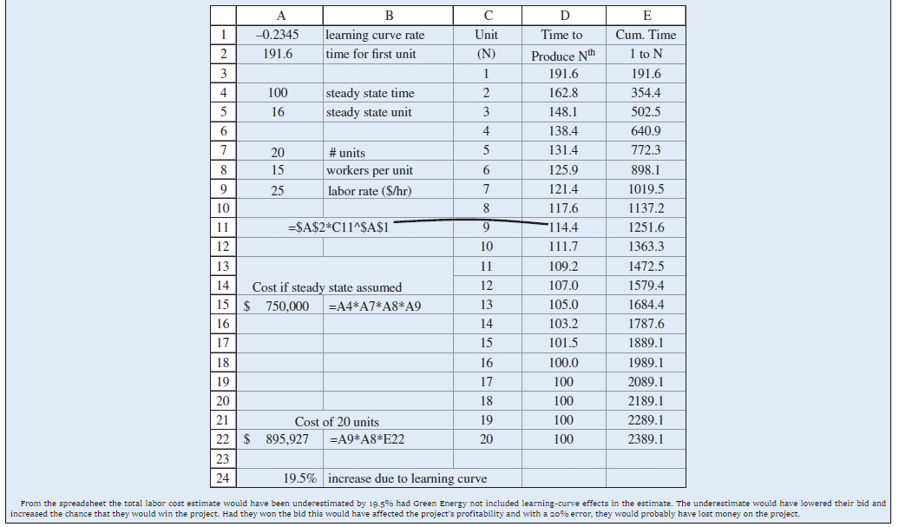



Example 2-10 Cost Estimating using Learning Curve
Known: T₁₆ = 100 hrs.
Learning-curve rate = 85%
Solution:

Slide 60
The 1st unit is made in 50 hours. With an 80% learning curve, how long for 10th?
85.8 hours
39.7 hours
29.1 hours
23.8 hours
I don’t know
Notes:
D

Slide 61
The 1st unit is made in 50 hours. With an 80% learning curve, how long for 10th?
85.8 hours
39.7 hours
29.1 hours
23.8 hours
I don’t know
b=log(0.80)/log(2) = −0.322
T₁₀ = 50 x (10)^{−0.3219} = 23.8
Notes:
D

Slide 62
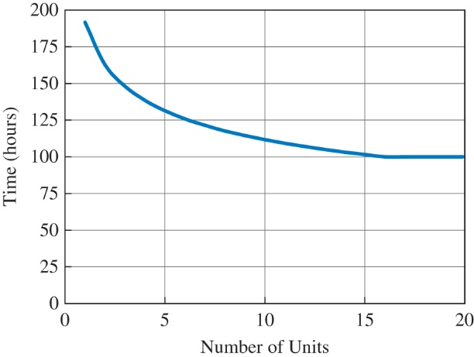
Figure 2-9 Learning curve of time vs. number of units

Slide 63
Cash Flow Diagrams (CFD)
CFD summarize costs & benefits occurring over time
CFD illustrate the size, sign, & timing of individual cash flows
Components of CFD
  A horizontal line divided into time units
  A vertical arrow for each cash flow when it occurs
  Arrows point down for costs & up for benefits

Slide 64
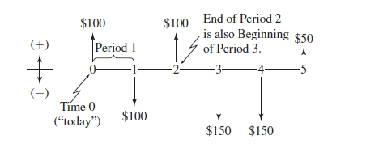
Cash Flow Diagrams (CFD)
Example
Timing of Cash Flow | Size of Cash Flow
At time zero (now) | Positive $100
1 time period from today | Negative $100
2 time periods from today | Positive $100
3 time periods from today | Negative $150
4 time periods from today | Negative $150
5 time periods from today | Positive $50
0
1
2
3
4
5

Slide 65
Categories of Cash Flows
First cost: expenses to build or to buy & install
Operations & maintenance (O&M): annual expense, such as electricity, labor, & minor repairs
Salvage value: money received at project termination for sale or transfer of the equipment
Revenues: annual receipts due to sale of products or services
Overhaul: major capital expenditure that occurs during the asset’s life

Slide 66
Drawing a Cash Flow Diagram
Shows when all cash flows occur
End of period t is same time as beginning of period t+1
Rent, lease, insurance payments usually treated as beginning-of-period cash flows
O&M, salvage, revenues, & overhauls are assumed to be end-of-period cash flows
Choice of time 0 is arbitrary

Slide 67
Drawing Cash Flow Diagrams with Spreadsheet
Year | Capital Costs | O&M | Overhaul
0 | -$80,000
1 |  | $(12,000)
2 |  | $(12,000)
3 |  | $(12,000) | $(25,000)
4 |  | $(12,000)
5 |  | $(12,000)
6 | $ 10,000 | $(12,000)

